Slide 1

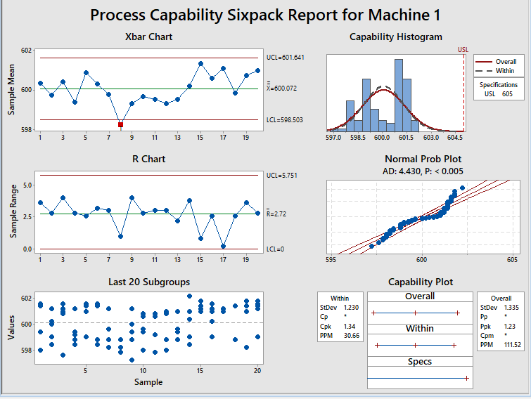
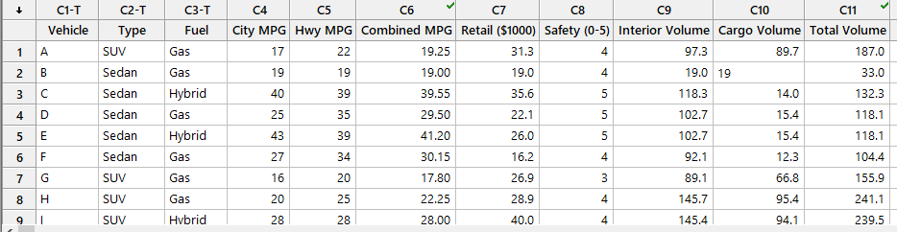
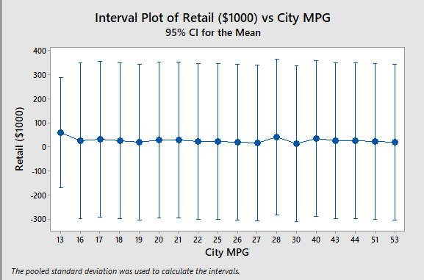
SHOWCASING DATA USING MINITAB
DATA MODELLING
Data Modeling refers to the practice of documenting software and business system design. The “modeling” of these various systems and processes often involves the use of diagrams, symbols, and textual references to represent the way the data flows through a software application or the Data Architecture within an enterprise. Data Modeling also includes practices such as business process modeling which deals with larger conceptual business process and decision making flows of entire organization
IPE-314
QUALITY MANAGEMENT SESSIONAL
Submitted To
AP Tanmoy Das
Submitted BY
Name: S.U.M RABBI HOSSAIN
Roll: 201636019

